Slide 2
Who We Are
Birmingham-based 501c3 non-profit
Established in 1972
Founded to address needs of teens living on the streets
“Aletheia” selected because it means “truth” or “ to be truthful with yourself”
United Way Agency

Slide 3
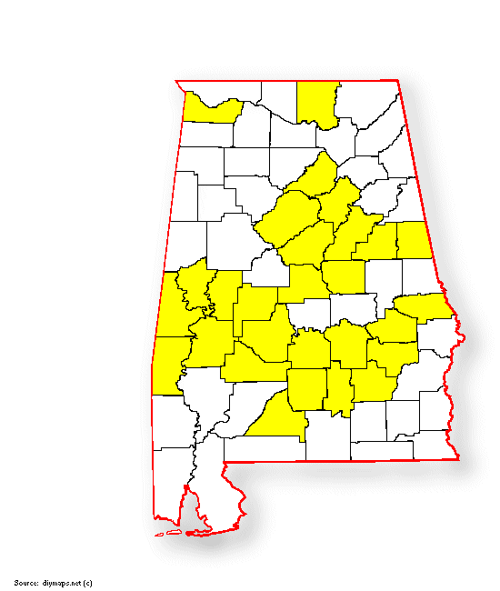
WHERE WE SERVICE
COUNTIES: Colbert, Madison, Blount, St. Clair, Jefferson, Shelby, Talladega, Clay, Randolph, Coosa, Chilton, Perry, Hale, Sumter, Marengo, Dallas, Lowndes, Choctaw, Montgomery, Butler, Conecuh, Crenshaw, Pike, Macon, Bullock, Lee, chambers, Tallapoosa, Russell county & Wilcox

Slide 4
What We Do
Substance Use Disorder Treatment (SUD)
Veteran Services
Prevention Services
Affordable Housing
Health Care for the Homeless

Slide 5
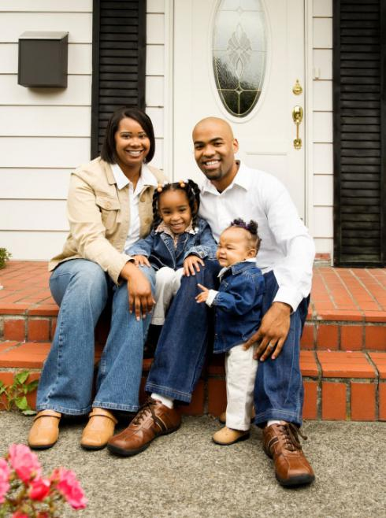
SUD Programs
Drug Court
Specialized Women’s
Residential
Outpatient Treatment

Slide 6
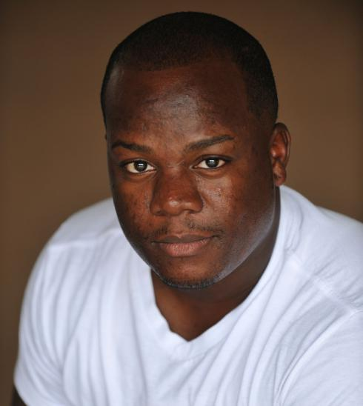
SUD Treatment: Drug Court Dallas, Montgomery, Wilcox, Butler, CRENSHAW & Jefferson co
The program is designed to provide treatment to adult men and women, 19 and over, who have drug-related offenses. Men and women who are assessed to be appropriate for an drug court and are referred by the Drug Court Judge.
This program offers court-involved substance users the opportunity to learn the skills and values they need to attain a drug free lifestyle. !

Slide 7
SUD Treatment: MOTHER’S Hope madison & JEFFERSON counties
The women’s outpatient program serves adult females, ages 19 and older, with substance use disorders, including women who are pregnant and postpartum and, who do not require the structure or intensity of inpatient treatment.
The program is designed to provide gender-responsive, comprehensive, integrated outpatient substance abuse treatment services, including: individual and group counseling, family counseling and education, HIV/AIDS education and, life skills training classes. !

Slide 8
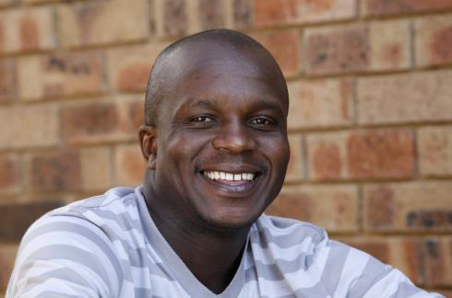
SUD Residential treatment: men
Residential treatment program for adult men in Birmingham, (Finley)/Montgomery (Capital City Treatment) Alabama.
Provides a full array of substance abuse treatment and supportive services in the transitional program that includes substance free residential living with supervision 24 hours a day, 7 days a week.
24 hour access to staff, clinical services personnel and daily clinical services that are designed to improve the client’s ability to structure and reorganize the tasks of daily living

Slide 9
SUD Residential treatment: St. AnnE’s /patton Women
Transitional residential program for women, including pregnant and post-partum women in Birmingham, Alabama.
Designed to be a 24 hour drug free environment for women who are enrolled in the women’s Intensive Outpatient Program.
24 hours access to emergency services, clinical staff and a registered nurse.
Provided the opportunity to participate in recovery oriented activities including 12 step meetings, physical exercise and substance free social activities. !

Slide 10
SUD Treatment Services
Assessment
Individual Counseling
Group Counseling
Family/partner Counseling
Psycho Education
Peer Coaching Support services
Mental Health Consultation
Medication management
Alcohol and drug screening
Sign Language Interpreter services
Oral Interpreter services
Smoking Cessation
HIV Early Intervention services
Case Management

Slide 11
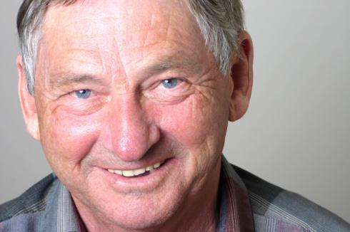
Outpatient Treatment: ADPH Ryan White lee county
Adults with HIV
Offers substance users the opportunity to learn the skills they need to attain a drug free lifestyle and protect their partners and themselves.
Sessions include recovery issues, criminal thinking, communication skills, stress management, relapse prevention, health education, HIV/AIDS education, decision-making and interpersonal relationship issues.5

Slide 12
Employment: Jobs for Vets Jefferson & Montgomery county
Helps homeless veterans re-integrate into meaningful employment by providing services that address their complex needs.
Works closely with other employment training programs to identify occupations that are in demand
Provides client-centered case management services, including transportation to these services.!

Slide 13
*VETERANS COMMUNITY WELLNESS:
Serve to educate veterans and their families on substance abuse prevention
Provides resources to veteran families already affected by substance abuse
Provide transportation services
Linkage to VA & other social services
Located in Birmingham !
* Brand New Program

Slide 14
Prevention: HIV Prevention
Reduce the incidence of new HIV infection in Alabama
Improve public understanding of involvement in, and support for HIV prevention
Prevent/reduce behaviors that transmit HIV
Develop partnerships for HIV prevention
Increase the number of MSMOC who are meaningfully engaged in HIV prevention services-with a focus on those men who are at greatest risk for HIV infection and those who are living with HIV/AIDS.

Slide 15
PREVENTION: HIV PREVENTION PROGRAMS
BCHIP2.0 (Jefferson County) Focused population are MSMOC
High Impact (Choctaw, Dallas, Hale, Lowndes, Marengo, Perry, & Sumter Counties) Focused HIV population are positive MSM, high risk HIV negative individuals, & Heterosexual individuals living in these counties.
Montgomery County

Slide 16
Prevention: COMMUNITY WELLNESS
Servicing in: Jefferson, St. Clair, Coosa, Marengo, Randolph, Clay, Talladega, Pike, Macon, & Bullock Counties
Provides summer camps for children and adolescents ages 6-18 during the months of June & July.
Educate children and adolescents on the dangers of substance abuse while also empowering youth to be advocates for positive change in their communities and schools.

Slide 17
COMMUNITY WELLNESS: OPIOID PREVENTION SHELBY, ST. CLAIR, & JEFFERSON COUNTIES
Servicing youth, ages 15-17, who are transitioning into adulthood
Young adults, ages 18-25, including college students.
The prevention of prescription drug use among youth and young adults who have not previously misused prescription drugs.
The reduction of prescription drug misuse among youth and young adults who are currently misusing prescription drugs. !

Slide 18
Housing Program: Temporary housing program
Aletheia House partners with UAB 1917 Clinic to provide transitional housing, emergency housing, and SUD treatment to 1917 Clinic patients.
Housing services include: case management services along with financial assistance including payment for application fee, rent, utilities, furniture, and household supplies.
SUD services include an ASAM assessment with program therapist, linkage to appropriate level of care treatment, and continuing care through individual and group sessions.

Slide 19
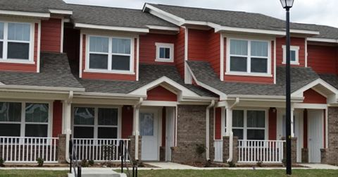
Affordable Housing
Aletheia House offers affordable housing to for those who qualify in the Jefferson, *Montgomery, Mobile, and Talladega Counties
For more information about our affordable housing programs please contact us at (205) 324-6502!
*Newly built homes

Slide 20
Primary Health Care
Aletheia House operates a federally qualified health center (FQHC), The Bessemer Neighborhood Health Center in Bessemer, Alabama. These services are primarily offered to homeless individuals in need of care. Behavioral health counseling, substance abuse treatment, and dental services are also offered at the clinic.
Brand New Mobile Unit: Screens for high blood pressure, COVID testing/vaccinations, HIV testing.
For more information, please contact our Director of Health Services, Dr. Sima Gupta, at (205) 277-6878.

Slide 21
*ASPIRING LEADERS
Brand new program located in Montgomery
Provides safe space for young adults 18-25 and their family members.
Provides comprehensive, family-centered, trauma informed, evidence-based treatment
Early intervention/recovery support –intensive outpatient care
Services Montgomery, Elmore, and Autauga counties
Services are provided free of charge
* Brand New Program
Notes:
Kids who aged out of foster care
Juvenile offenders released from Department of Youth Services
Completed Job Corps program
Returning to community from jail or prison
Experiencing homelessness
Experienced sexual assault
Living with HIV
Females or minorities who experienced health disparities

Slide 22
Contact us
1153 Air Base Boulevard
Montgomery, AL 36108
Phone: (334) 265-4544
Ext: 258/259/261
Website: www.specialkindofcaring.org

Slide 23
Any Questions?

Slide 24
My Test: Are You Ready?
Who can answer this one question?

